Slide 1
CHEF - Configuration(Each and every minute detail of machine like Server,Storage etc) Management (Like Delete,Update,Create etc..) Tool
Two Types of Configuration Management Tools
• Push Based : Server pushes configuration to the nodes(Ansible,Salt Stack)
• Pull Based : Nodes check with the server.Periodically and fetches the configuration from it.(Chef,Puppet)
CHEF :
• Chef is a company and the name of a configuration management tool written in Ruby and Erlang
• Founded by Adam Jacobs in year 2009
• Actual name was “Marionette” later renamed to Chef
• On April 2,2019 the company announced that all their products are now open source under the Apache 2.0 License
• Chef is used by Facebook,AWS Opsworks,Hp Public Cloud etc
• Chef is a Admin. tool whatever system admins use to do manually,now we are automating all those tasks by using chef

Slide 2
Configuration Management : It is a method through which we automate admin tasks
• Config management tool turns our code into Infrastructure
• So our code would be repeatable testable and versionable
Advantages of CM Tools:
• Complete Automation
• Increase Uptime
• Improve Performance
• Ensure Compliance
• Prevent Errors
• Reduce Costs

Slide 3
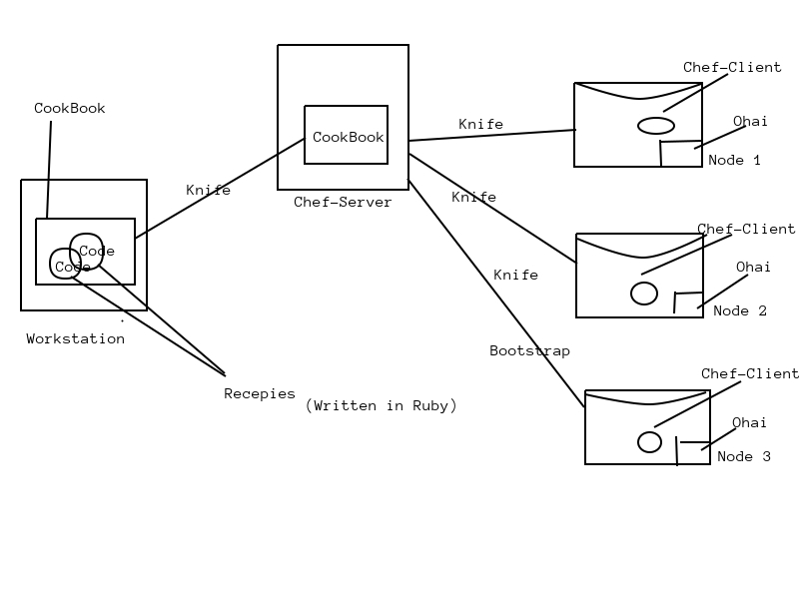
Chef-Architecture or Process :

Slide 4
Components of Chef :
Workstation :Where we write code
• Workstations are personal computers or Virtual Servers where all configuration code is created,tested or changed
• Devops engineer actually sits here and write codes.This code is called recipe.A collection of recepies are called CookBooks
• Workstation communicate with the chef server using knife
• Knife is a command line tool that uploads the cookbook to the server
Chef-Server: Where we store code
• The chef-server is a middle-man between workstation and the nodes
• All cookbooks are stored here
• Server may be hosted locally or remote
Node : Where we apply code
• Nodes are the systems that require the configuration
• Ohai fetches the currents state of the node its located in
• Node communicates with the chef-server using the chef-client
• Each node can have a different configuartion required
• Chef-client is installed on every node

Slide 5
Knife : Tool to establish communication among workstation,server and node knife is a command-line tool that runs on workstation
Chef-Client : Tools runs on every chef node to pull code from chef server
• Chef client will
☐ gather current system configuration
☐ download the desired system configuration from the chef server
☐ Configure the node such that it adhere to the policy
Ohai : Maintain Current state information of the chef-node
Idempitency : Tracking the state of system resources to ensure that the changes should not reapply repeatedly
Chef-SuperMarket : Where we get custom Code

